Slide 1
Employing Blockchain Technology for Decentralized Crowdsourced Data Access and Management
By Moon Moore

Slide 2
The problem
How can we solve the issues of data access, management, and analysis along with user privacy and trust preservation within a data crowdsourcing application?
Our solution utilizes newer technologies, namely blockchain, to approach these issues

Slide 3
Details of the project
OMNI holds multiple datasets (59 as of now)
We want to allow for the crowdsourcing of these datasets by scientists
We also want to be able to keep track of who has gained access to said datasets
This tracking is handled by tracking the successful requests of data (transactions) through the use of blockchain technology

Slide 4
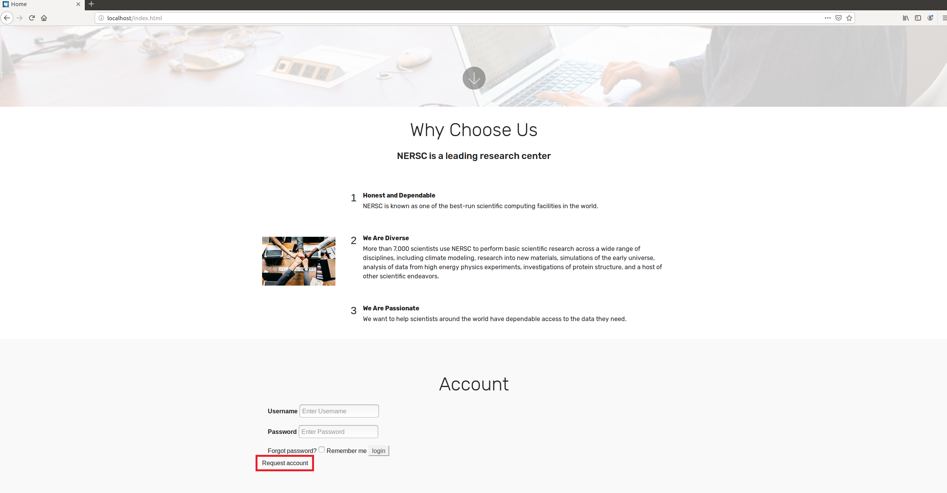
How requests are made
A user comes to our website
In order to view what datasets are available and to make requests they must first request an account
This request sends an email to a NERSC admin who must approve or deny it

Slide 5
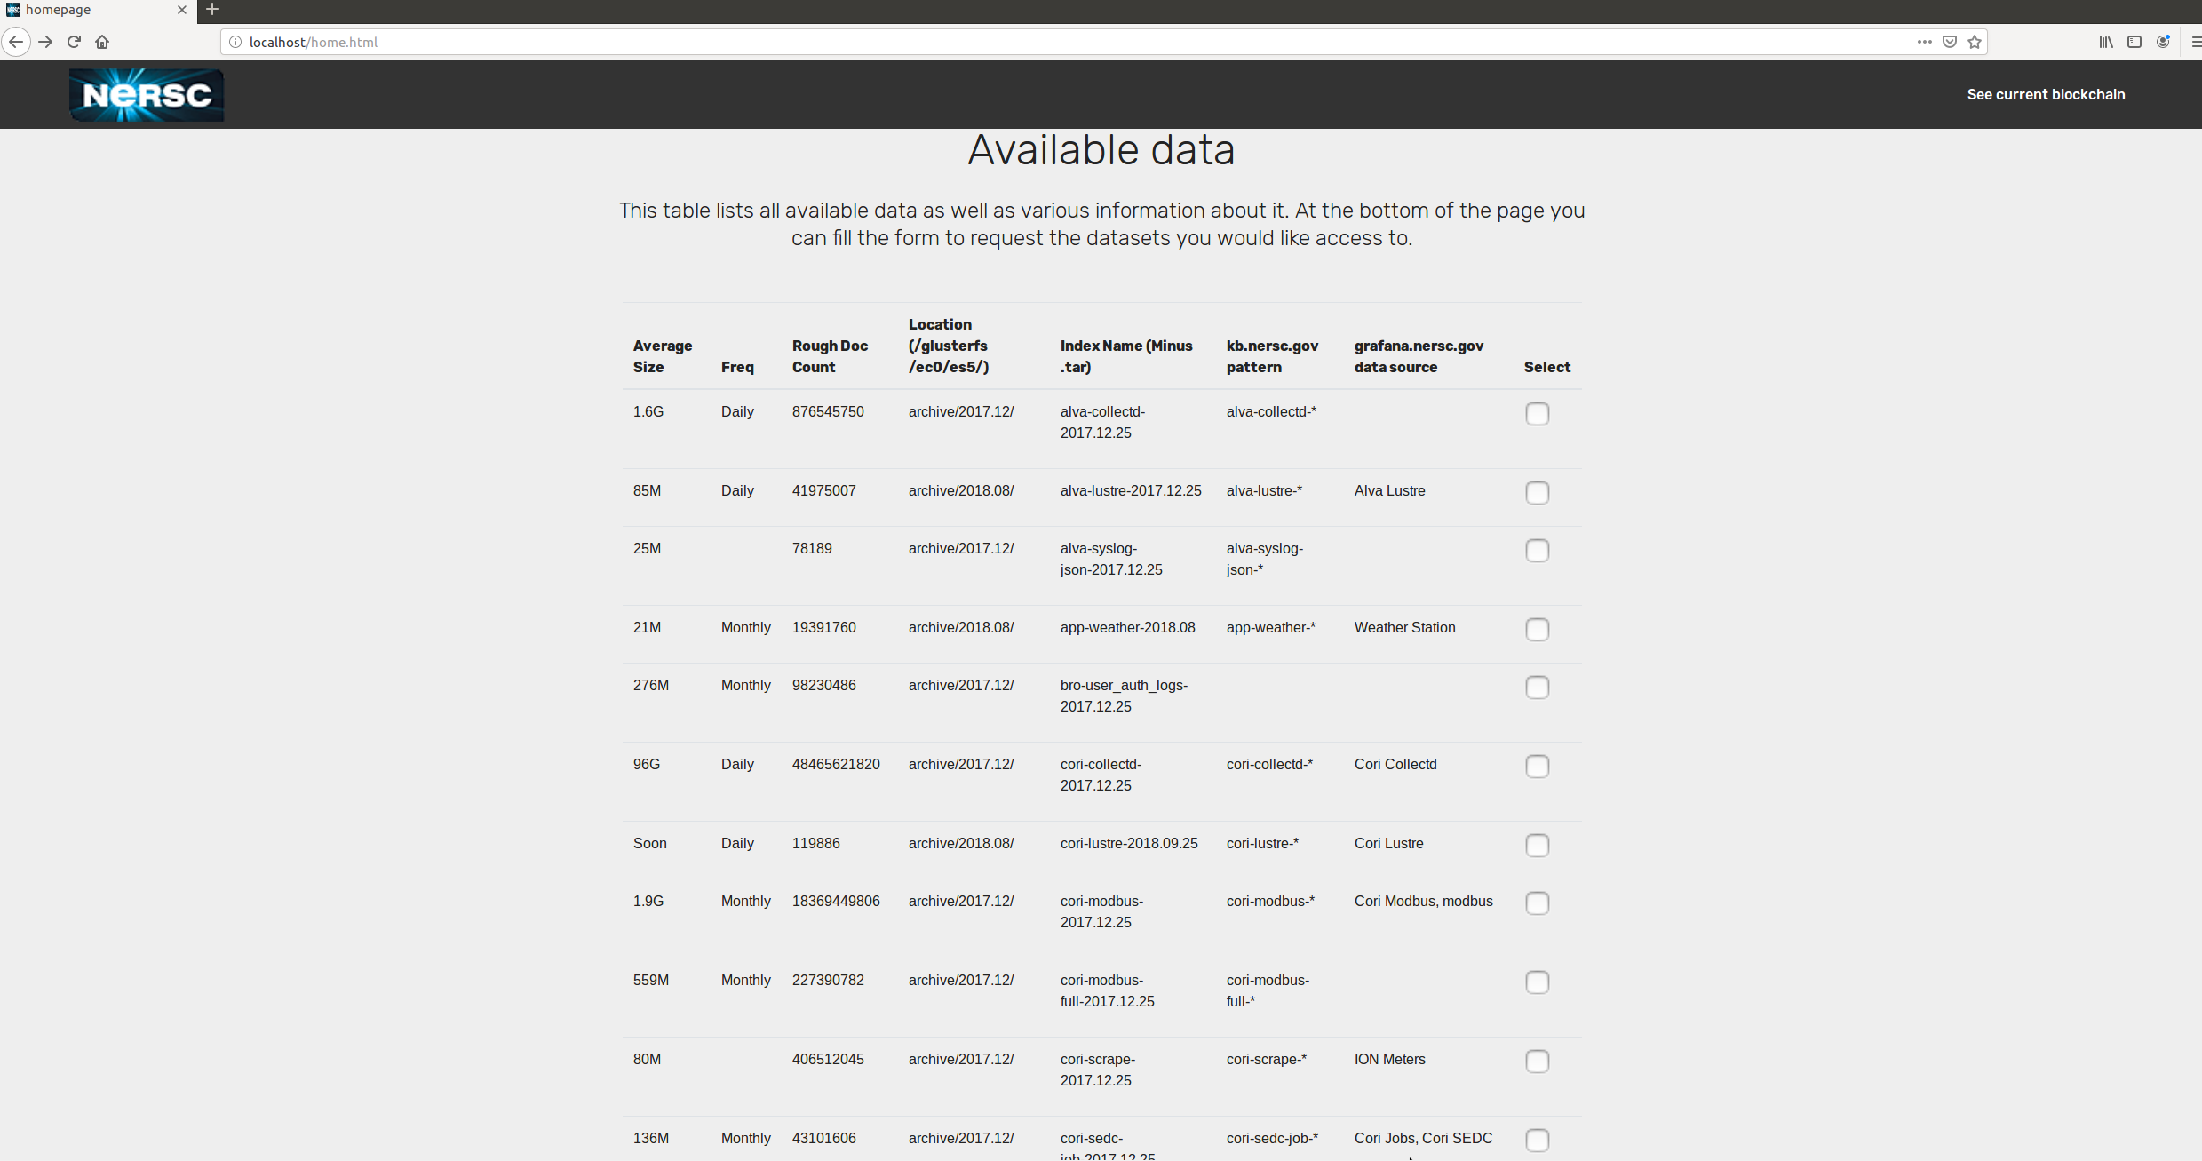
How requests are made (cont.)
After logging in the end user would be able to view all of the currently available datasets
The user can pick and choose which datasets they would like access to, the date range of these datasets, and make any comments or special requests within this form
This request is sent to a NERSC admin in the same way as an account request

Slide 6
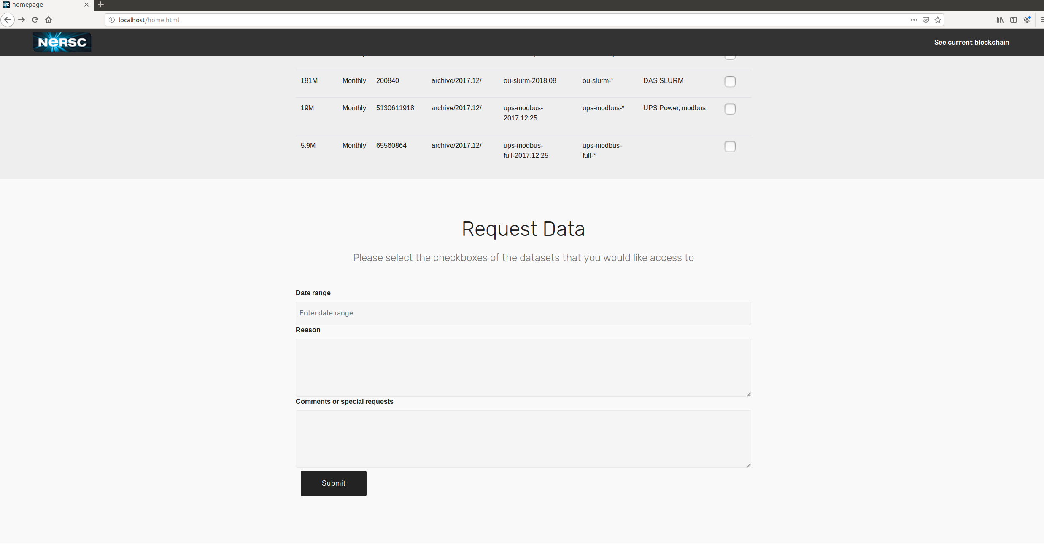
How requests are made (cont.)

Slide 7
Blockchain intro
Blockchain is a hot-topic new “technology” in which the “block” is the digital information stored in the public database which is the “chain” of blocks
In its most basic form a blockchain is simply a record of transactions stored within in a shared immutable ledger
Transactions can be whatever the programmer wants them to be, digital currency transactions, healthcare information records, car sales, etc.

Slide 8
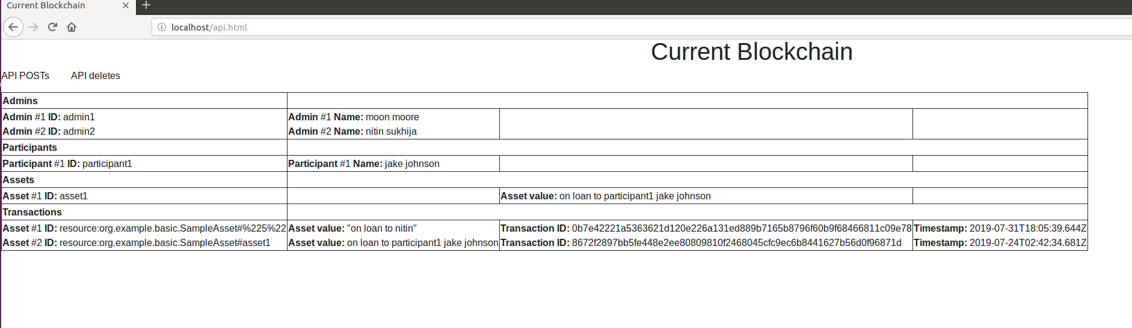
The blockchain
The end user will also be able to view the current blockchain (though this can be changed if we wish to keep the blockchain private)
Below you can see some samples of what the blockchain will look like

Slide 9
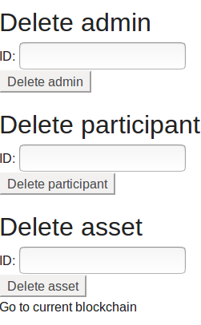
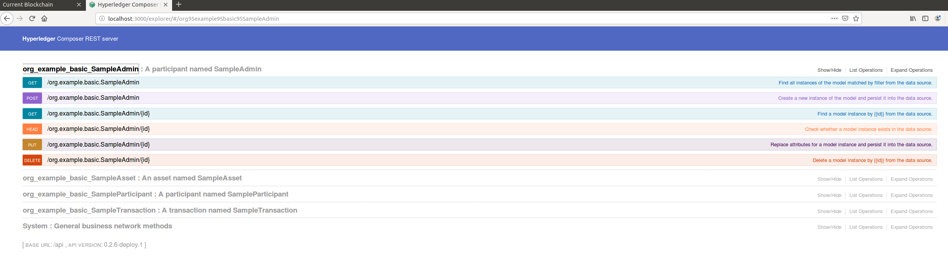
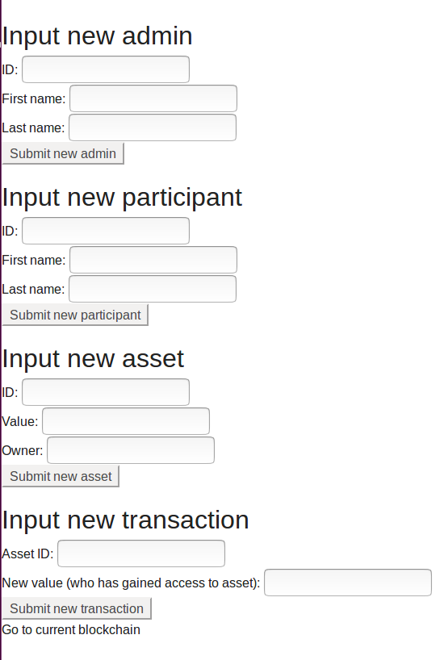
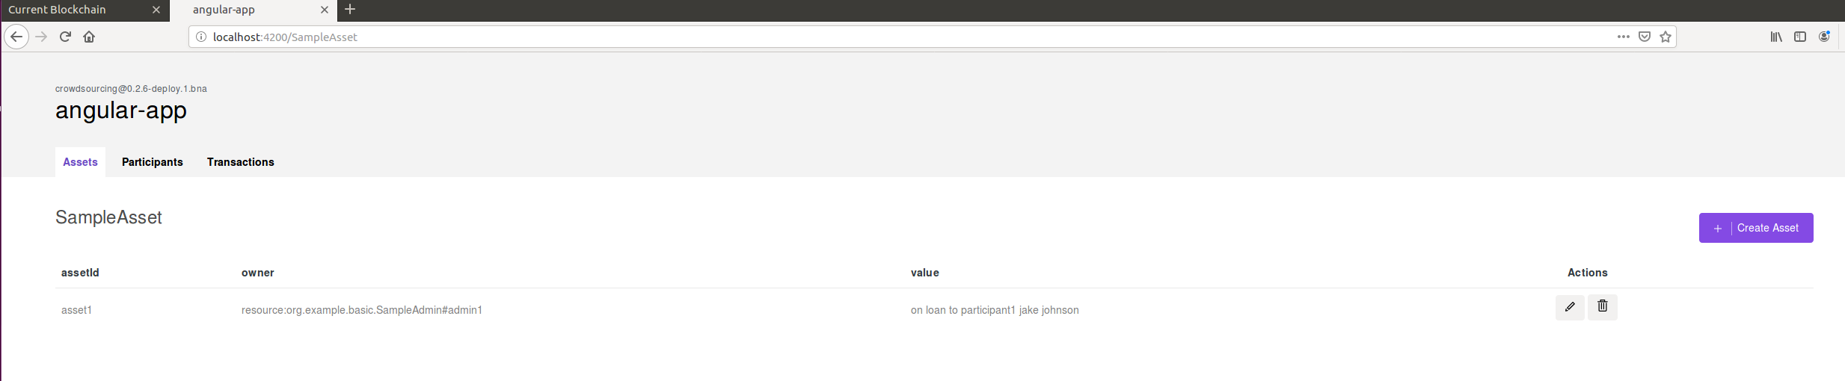
The blockchain (cont.)
The viewing of and editing of the blockchain (excluding the editing of transactions) is handled through the use of API calls to the local REST server
This viewing and editing can also be handled locally either on the REST server or through the angular app that is generated through Hyperledger Fabric

Slide 10
Future work
The addition of a database for the website, ideally mongoDB
Website security features
Automation of blockchain features
Addition of redundancy for the blockchain, ideally daily backups
Addition of authentication methods within API calls

Slide 11
Questions?
This work has been published
We plan on continuing work on this project as well as publishing a book chapter on it

